Slide 1
Data Science Capstone Project Assignment 3
Lim Wee Liang Kelven
Wee Xiang Tiew
Chua Chow Lee Marcus
Jia Xin Ally Koh
Muhammad Nuriman

Slide 2
Table of Contents
01
02
03
Team
Team Introduction
Architecture Overview
Individual
Screenshots of Alteryx Workflows and Power BI dashboards
Insights
Team
Telegram bot
Scrum artefacts

Slide 3
Team Introduction
Name | Dataset(s) | Role
Ally | Card Access | Clean data, visualise data
Iman | Water Metering | Clean data, visualise data
Wee Xiang | Toilet Utilisation, Solar Energy | Clean data, visualise data
Marcus | Fault Reporting | Clean data, visualise data
Kelven | Energy Consumption, Canteen Crowd | Clean data, visualise data

Slide 4
Energy Consumption
Lim Wee Liang Kelven

Slide 5
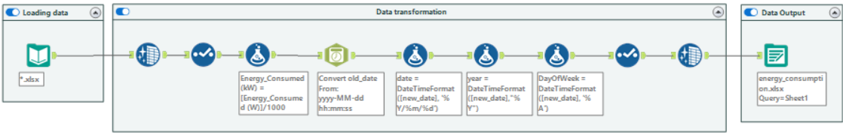
Alteryx (Before)
By: Lim Wee Liang Kelven
Notes:
For energy consumption, I made some changes to my Alteryx workflow. This is what it looks like before.

Slide 6
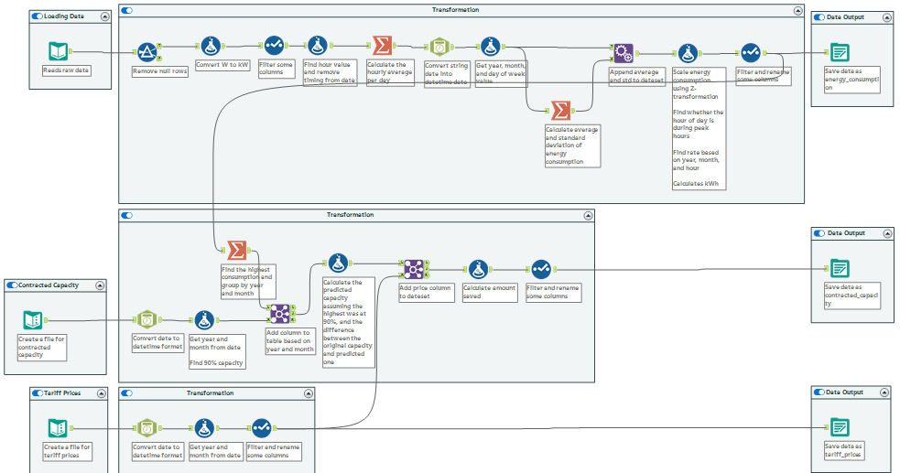
Alteryx (After)
By: Lim Wee Liang Kelven
Notes:
And this is what it looks like after. I made references to SP Group’s electrical tariff prices.

Slide 7
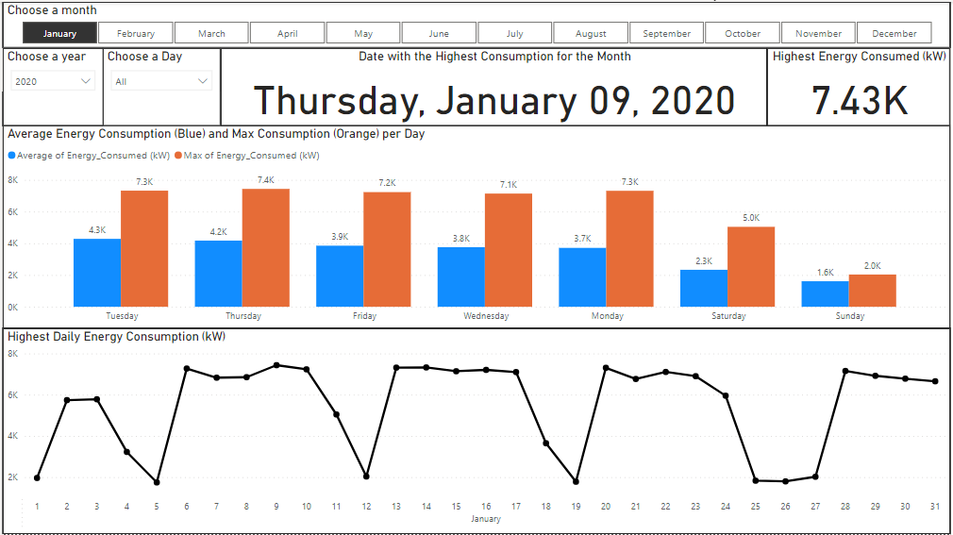
Energy Consumption Overview (Before)
By: Lim Wee Liang Kelven
Notes:
For energy consumption overview, this is what it looks like before.

Slide 8
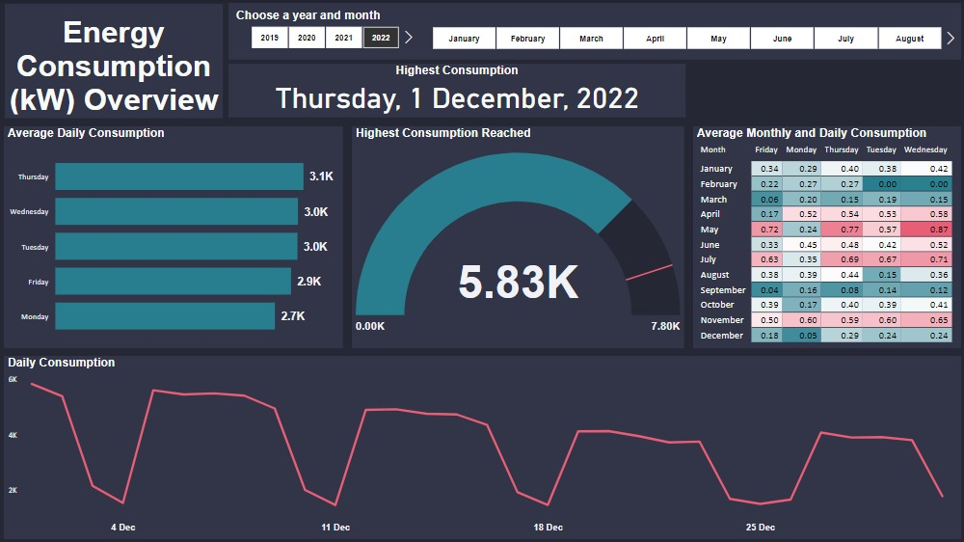
Energy Consumption Overview (After)
By: Lim Wee Liang Kelven
Notes:
This is what it looks like after. The main changes are the gauge chart to compliment the card showing the date with highest consumption, and the heatmap showing how month and day of week affects energy consumption.

Slide 9
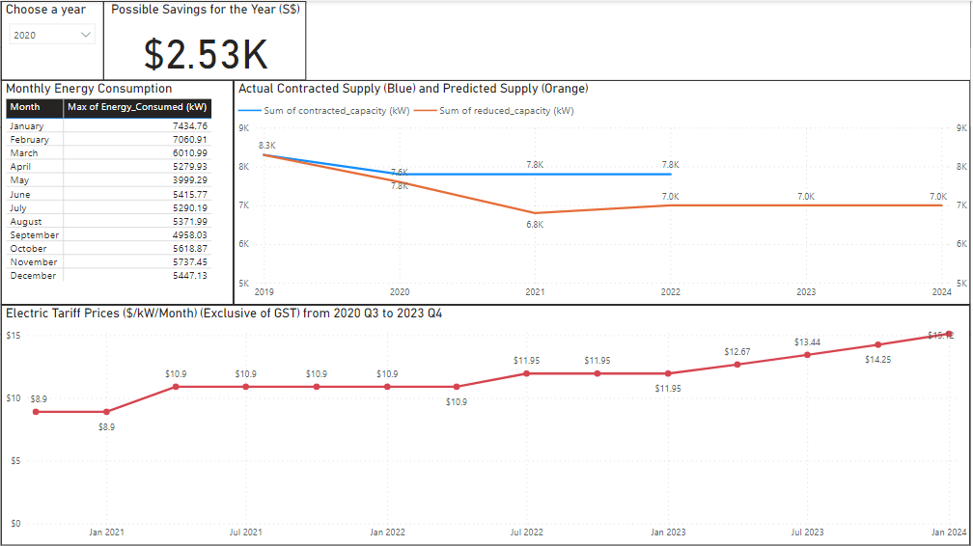
Energy Pricing (GST Inclusive) (Before)
By: Lim Wee Liang Kelven
Notes:
For energy pricing overview, this is what it looks like before.

Slide 10
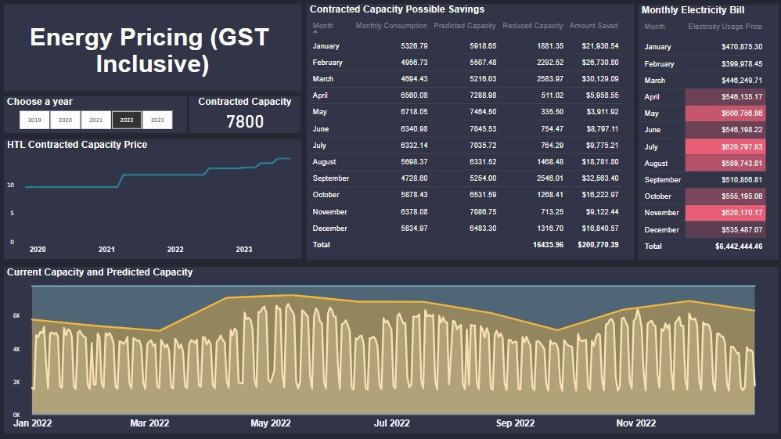
Energy Pricing (GST Inclusive) (After)
B b
By: Lim Wee Liang Kelven
Notes:
This is what it looks like after. The main changes are the table showing the amount of reduced capacity and amount saved, and the line chart comparing the actual contracted capacity with the predicted capacity.

Slide 11
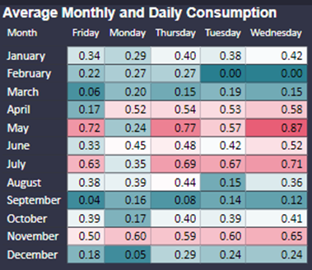
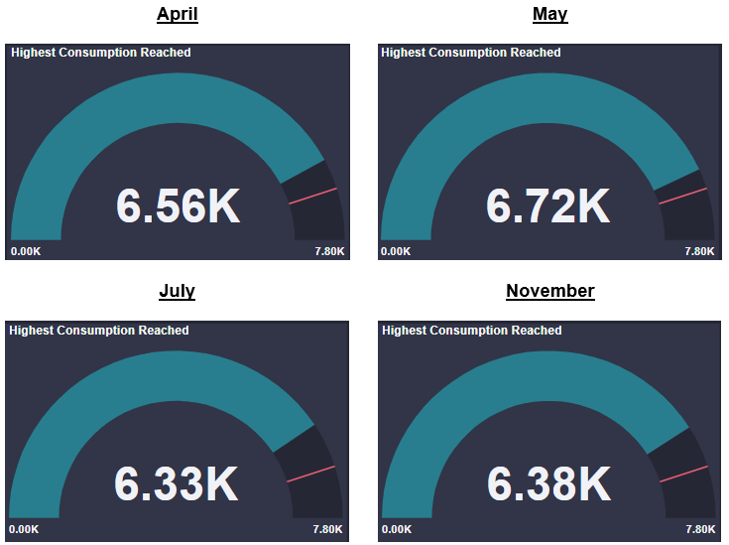
Insights
By: Lim Wee Liang Kelven
In 2022, Apr, May, Jul, and Nov had higher energy consumption, but did not exceed 90% capacity.
Notes:
Energy Consumption Overview (ECO)
In 2022, it is observed that April, May, July, and November had higher consumptions than other months. However, even though they had high consumption, they did not exceed 90% of the contracted capacity. This can be seen using the gauge chart in ECO. The values for the different months are changed using the month slicer.

Slide 12
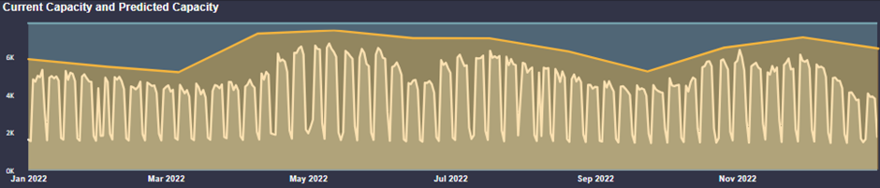
Insights
By: Lim Wee Liang Kelven
This is a comparison between the actual contracted capacity and my predicted capacity.
Instead of having a static capacity throughout the year, the capacity can be adjusted monthly to just meet expected demand.
Notes:
This is a comparison between the actual contracted capacity and my predicted capacity.
Instead of having a static capacity throughout the year, the capacity can be adjusted monthly to just meet expected demand.

Slide 13
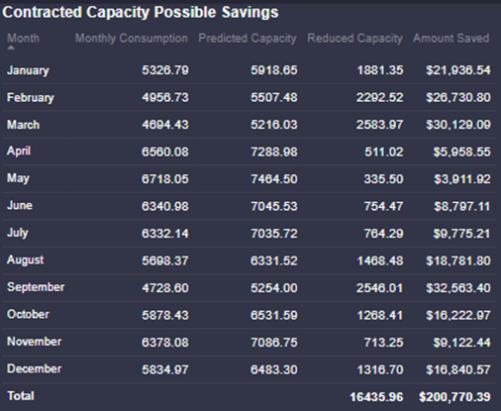
Insights
By: Lim Wee Liang Kelven
If 2023’s consumption pattern is the same as 2022’s, the contracted capacity can be reduced by a total of 16,435 kW leading to a savings of $200,770.
Notes:
The adjustments each month could lead to a total reduction of 16,435 kW in contracted capacity amounting to a yearly savings of $200,770.
Assuming 2023’s energy usage pattern is the same as 2022’s.

Slide 14
Insights
By: Lim Wee Liang Kelven
With this reduced capacity, the school might hit 90% capacity during Feb, May, and Nov.
Notes:
With this reduced capacity, the school might hit 90% capacity during Feb, May, and Nov.
Assuming 2023’s energy usage pattern is the same as 2022’s.

Slide 15
Insights
By: Lim Wee Liang Kelven
Not enough information to predict 2024’s contracted capacity.
If the school saves 100 - 200 kW per month, it could save 1200 - 2400 kW in 2024.
Saves $17,424 - $34,848 in 2024
Notes:
So far, it is not possible to accurately predict 2024’s contracted capacity due to a lack of information about 2023’s consumption trend. Despite this, it is possible to make some assumptions. If we assume the school becomes more energy efficient each year, it can further reduce its contracted capacity. If the school and especially students put in sufficient effort, this could be reduced by an additional 100 to 200 kW per month.
Thus, at the current rate of $14.52/kW of July 2023 – October 2023, the school could save at least $17,424 to $34,848 (GST inclusive).

Slide 16
Water Metering
Muhammad Nuriman S10227895A
Notes:
Now, I will be going through my part on Water Metering. *Next Slide*

Slide 17
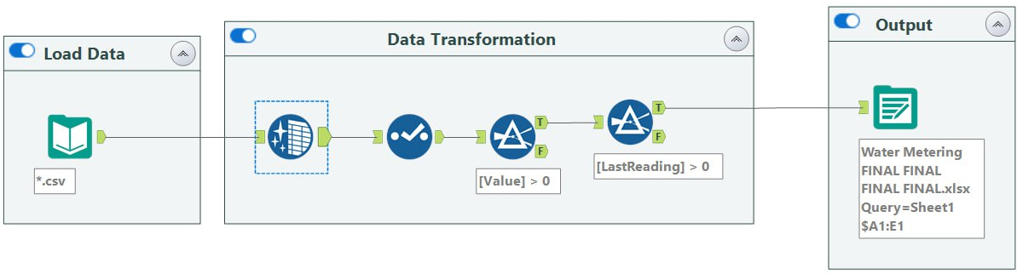
Alteryx Solution (Before)
By: Muhammad Nuriman
Notes:
For Water Metering’s Phase 2 Dataset, I have cleaned it using Alteryx Designer. The image shows the tool used in Alteryx without annotations. *Next Slide*

Slide 18
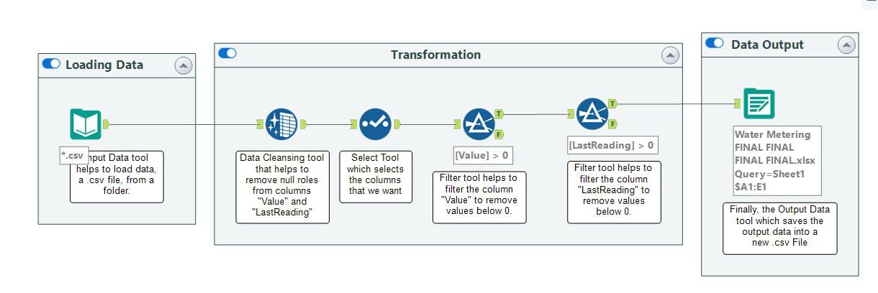
Alteryx Solution (After)
By: Muhammad Nuriman
Notes:
This is the finalised version of my Alteryx Solution. Firstly, I loaded the dataset, which is a .csv file, into Alteryx Designer.
For the transformation part, there were a number of null rows in both the columns "Value" and "LastReading". To tackle this issue, I used the Data Cleansing tool to remove the null rows in both the columns. Once removed, I used the select tool to select the columns that I want, which are "Value" and "LastReading".
So for the last 2 tools in transformation, I used the filter tool to filter out values below 0 for the column's "Value" and "LastReading". I excluded values below 0 since negative readings for the water meter would not be logical.
Finally, I then saved the output data into a new .csv file using the Data Output tool.a

Slide 19
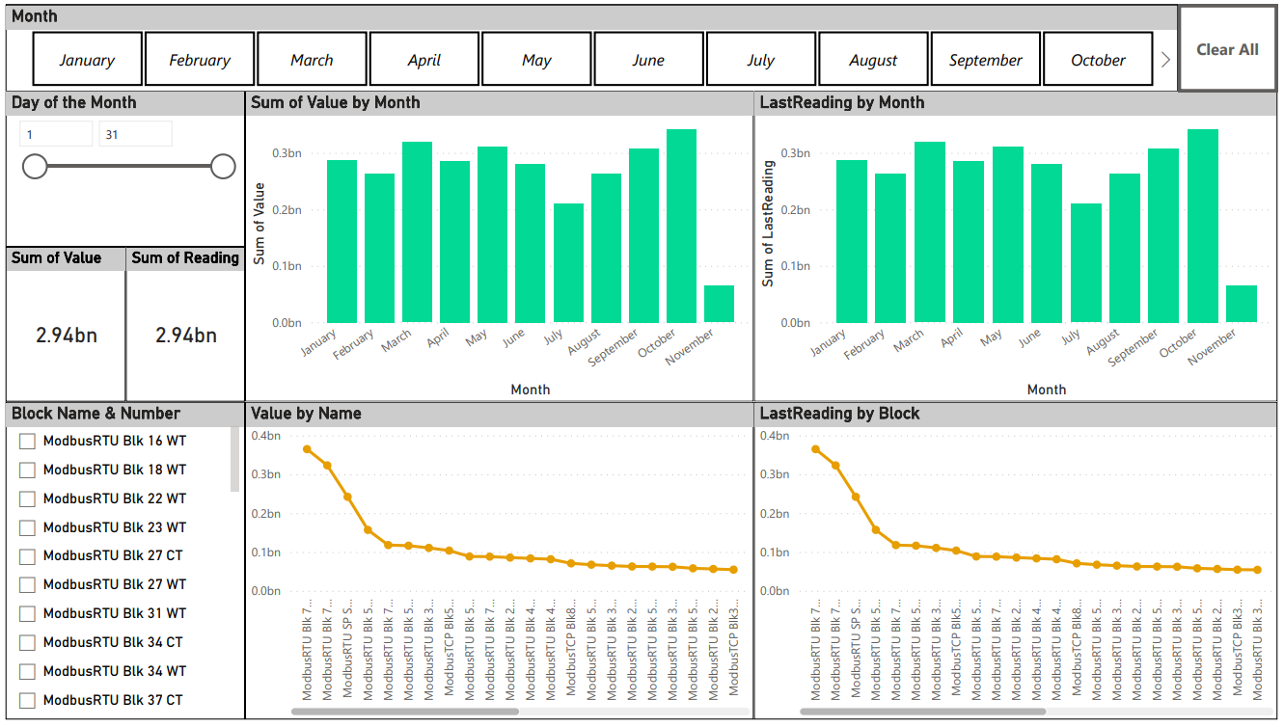
Dashboard (Before)
By: Muhammad Nuriman
Notes:
After Data Cleaning, I use the cleaned dataset to create visuals in Microsoft Power BI. This is the dashboard in the early stages. *Next Slide*

Slide 20
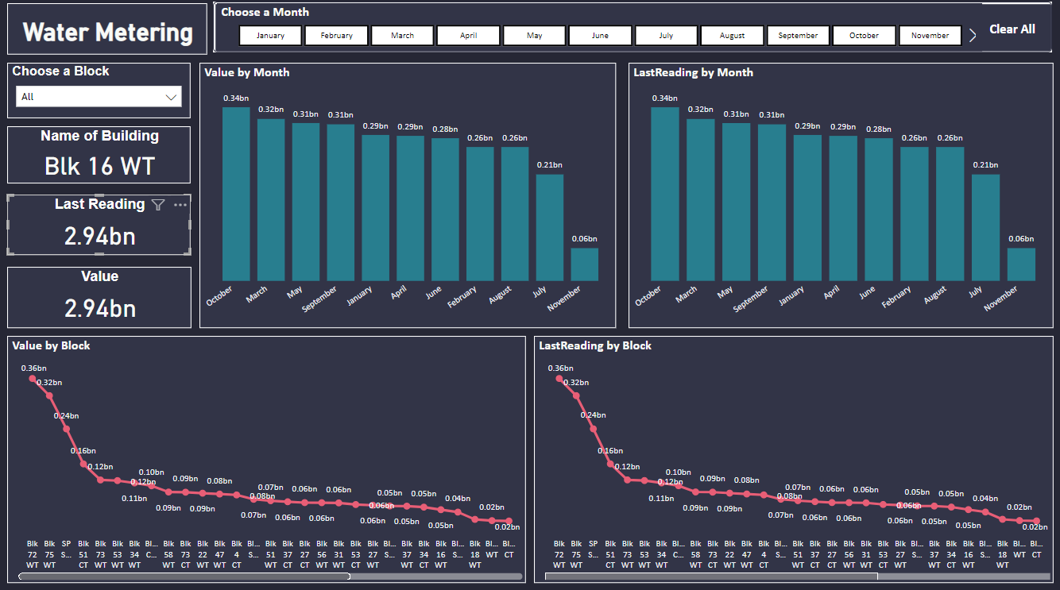
Dashboard (After)
By: Muhammad Nuriman
Notes:
And this is the final dashboard. After Data Cleaning, I use the cleaned dataset to create visuals in Microsoft Power BI.
Firstly is "Value" which refers to the water meter reading in cubic meters.
Second is "LastReading" which refers to the last reading, 1 hour BEFORE, for water meter reading in cubic meters.
So the 2 bar charts show Value AND LastReading by MONTH.
We can see that the month, October, has the highest value in both bar charts.
And below, we can see 2 line charts, both showing Value and LastReading by Block. The top 5 blocks are both the same for both visuals, so the top 5 are Blk 72 WT, Blk 75, WT, SP Small, Blk 51 CT, Blk 73 WT.

Slide 21
Insights
By: Muhammad Nuriman
Blk 72 WT has the highest value for both “Last Reading” and “Value”.
October 2022 has the highest value for both “Last Reading” and “Value”.
Places with the highest value for both “Last Reading” and “Value”:
Blk 72 WT (Water Tank)
Blk 75 WT (Water Tank)
SP Small (Swimming Pool Small)
Blk 51 CT (Cooling Tower)
Blk 73 WT (Water Tank)
There could be a potential leakage in these blocks. The high usage might be due to leaks, a faulty meter or high usage of water due to seasonal changes for cooling tower.
Notes:
For Insights:
Both Block 72 Water Tank and the month, October, has the highest value for both "Last Reading" and "Value".
As mentioned, these are the top 5 places with the highest value for both attributes.
My theory is that there could a potential leakage in these blocks. For the blocks with Water Tanks, there could either be a leakage, overflow, metering errors or inefficient water usage practices.
As for the Small Swimming Pool, it could be due to leaks, splashing of water during recreational activities, or overfilling.
Finally, for the Cooling Tower, it could be due to leaks or high usage due to the hot weather in Singapore.

Slide 22
Card Access
Koh Jia Xin Ally S10222783D
Notes:
Moving to Card access,

Slide 23
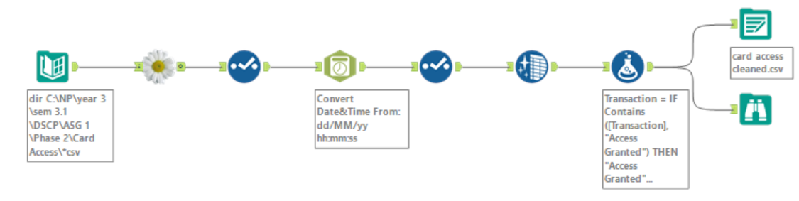
Alteryx (Before)
Ally Koh
Lack of Annotation
Null rows were still present
Lacked certain features for analysis
Notes:
For Card Access, this is the previous Alteryx solution completed in assignment 2 which had little annotations and the final “cleaned” dataset lacked certain features.

Slide 24
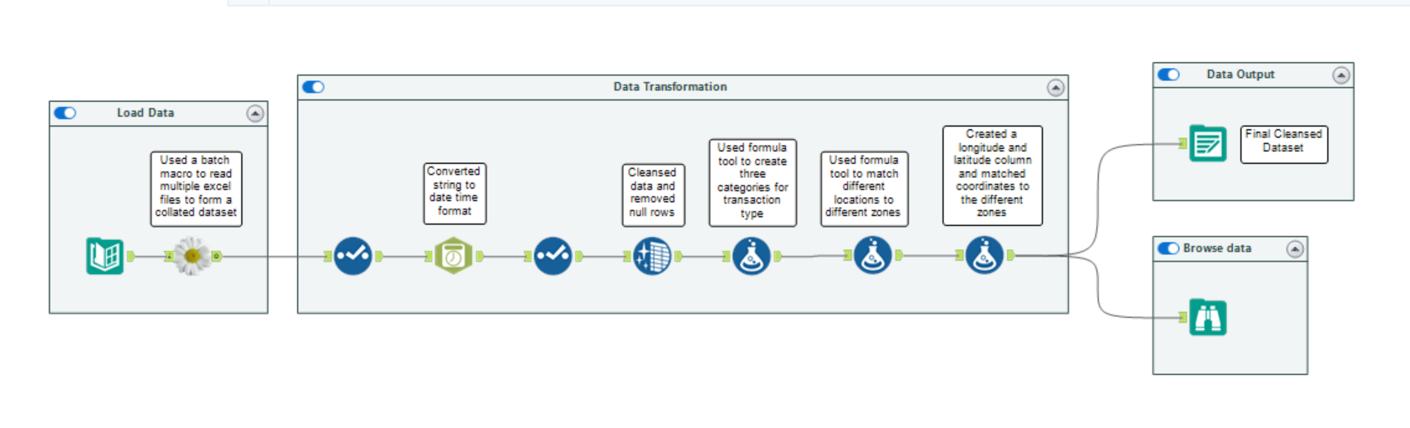
Alteryx (After)
Ally Koh
Added annotations
Removed null rows
Used Formula tool to match different locations to different zones
Created longitude and latitude column
Notes:
In this assignment, the Alteryx solution was improved by using annotations and the different tools were also grouped into different boxes. Null rows were removed and 3 new columns were created; locations in Ngee Ann Polytechnic were grouped based on Zone numbers to create the ‘Zone’ column and Each zone was then assigned longitude and latitude coordinates. Longitude and latitude columns were hence created.

Slide 25
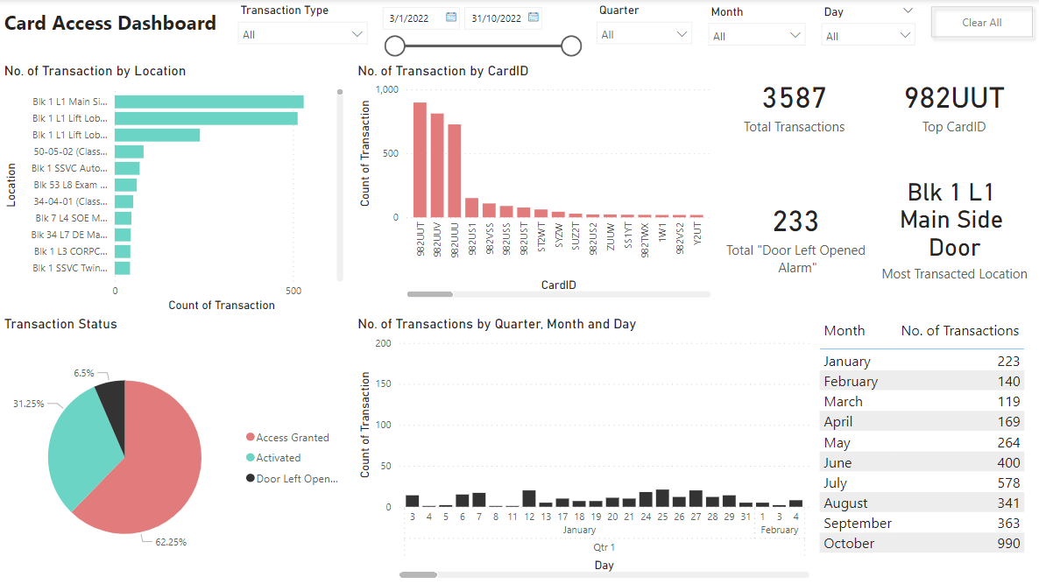
Card Access: Dashboard (Before)
Ally Koh
Notes:
This is the Card Access dashboard completed for the previous assignment

Slide 26
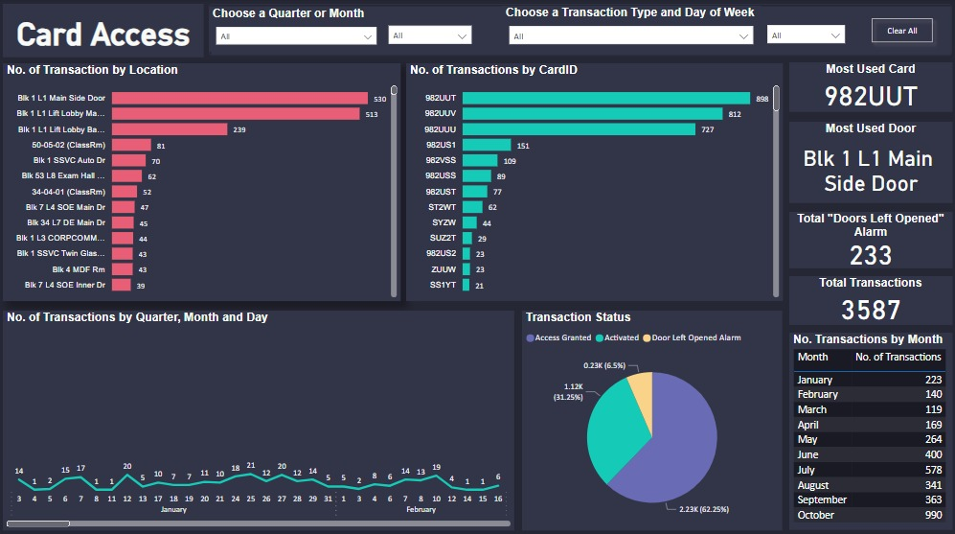
Card Access: Dashboard (After) Page 1
Ally Koh
Notes:
To improve on the previous dashboard, a new color palette was implemented which is much more soothing for the eyes. The initial stacked column chart has also been changed to a line chart and data labels were added to every visual. The slicers on top have also been redesigned, making it more user friendly.

Slide 27
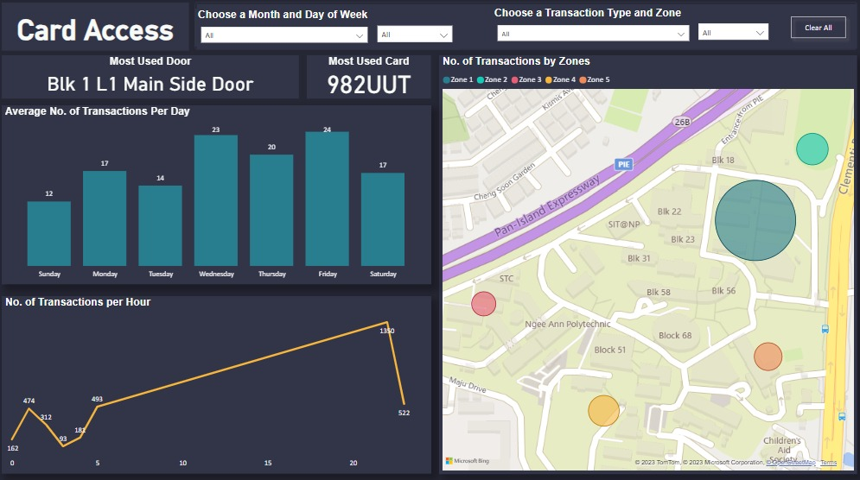
Card Access: Dashboard Page 2
Ally Koh
Notes:
Adding on, a new dashboard page was also created to input new visuals. A new map visual was created using the new longitude and latitude columns created on Alteryx. This visual shows the number of transactions in each zone. A line chart and stacked column chart was also created, showing the number of transactions per hour and average number of transactions per day respectively.

Slide 28
Insights
Ally Koh
Time interval with the highest card access activity:
10 pm to 1 am, with 10 pm experiencing the peak activity, averaging 436 transactions.
Top 3 locations with highest potential security risk:
"Blk 1 L1 Main Side Door," "Blk 1 L1 Lift Lobby Main Door," and "Blk 1 L1 Lift Lobby Back Door".
Top three CardIDs associated with frequent "Door Left Opened Alarm" status:
982UUT, 982UUV, 982UUU
Notes:
Some crucial findings from this project include the time interval with the highest card access activity, the top 3 locations with the highest potential security risk, as well as the top 3 CardIDs with the most “Door Left Opened Alarm” transactions.
By identifying high-risk hours and locations with increased card access activity, facility managers can implement targeted security measures to ensure the safety of campus personnel and protect valuable assets. The ability to address individuals triggering "Door Left Opened Alarm" statuses empowers facility managers to take proactive measures in minimizing security breaches and unauthorized access. These insights enhance the overall efficiency of facility management practices, creating a safer and more secure campus environment.

Slide 29
Fault Reporting
Chua Chow Lee Marcus

Slide 30
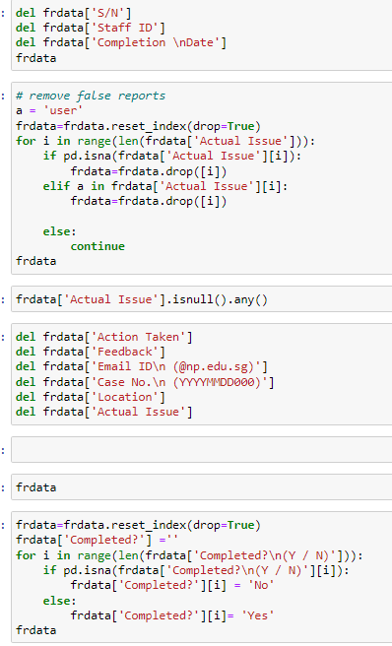
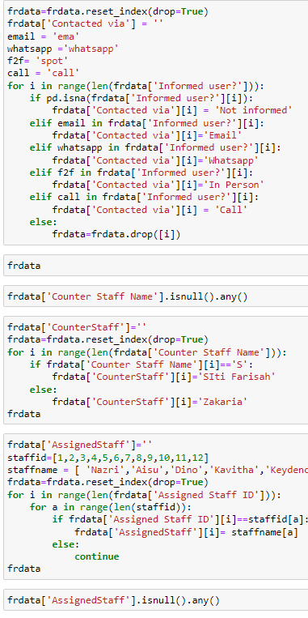
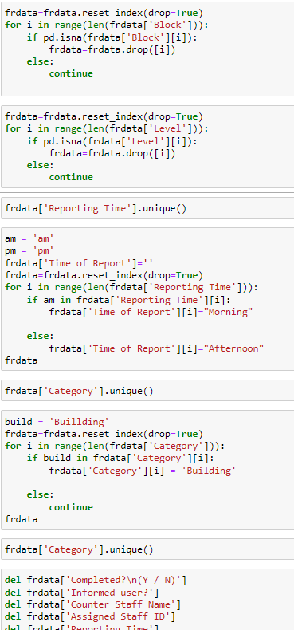
Cleaning of Data(Before)
Notes:
This is my data cleaning in phase 1 with Jupyter.

Slide 31
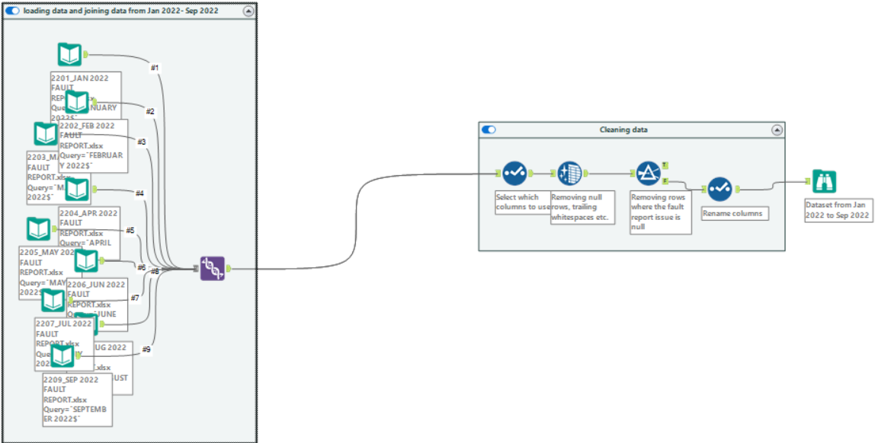
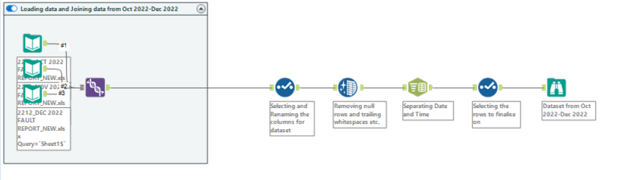
Cleaning Dataset(After)
Notes:
This is my data cleaning with alteryx for phase 2. I changed as I was dealing with a large number of data sets. I used the data that is in 2022. As there are 2 different formats, I merged the ones with the old format together, I also did this for the new datasets.I used select tool to select and rename my columns, data cleansing tool to remove null and trailing whitespaces. I used the filter tool to remove null inputs for certain columns. The text to columns tool was used for me to separate date and time.

Slide 32
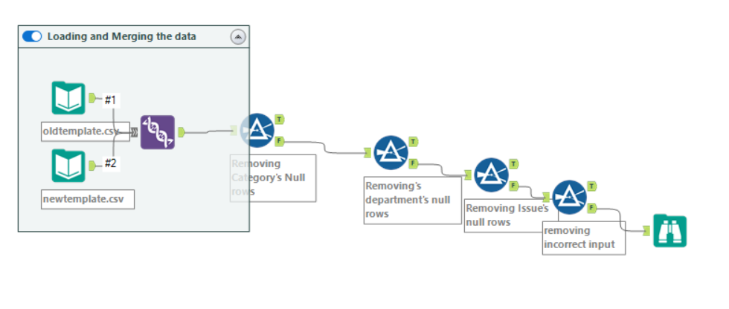
Cleaning Dataset(After)
Notes:
After making the formats for the old and new datasets the same, I merged them and followed by removing null inputs for category, department, issue and incorrect inputs using the filter tool.

Slide 33
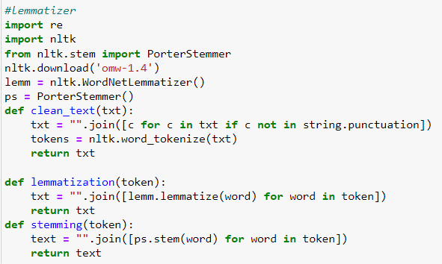
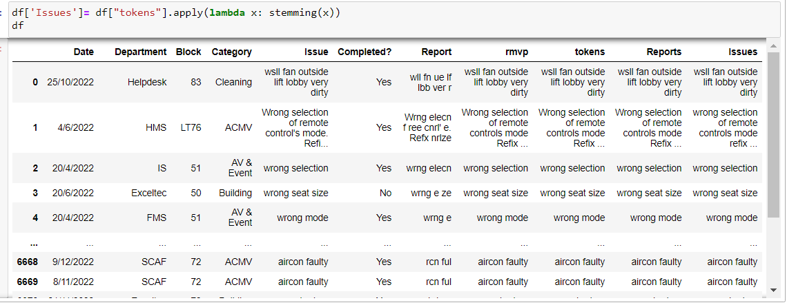
NLP on Jupyter
Notes:
For my last step in data cleaning, I did Natural Language Processing. The first function is used to remove the punctuation and tokenize the text before stemming or lemmatizing the text.

Slide 34
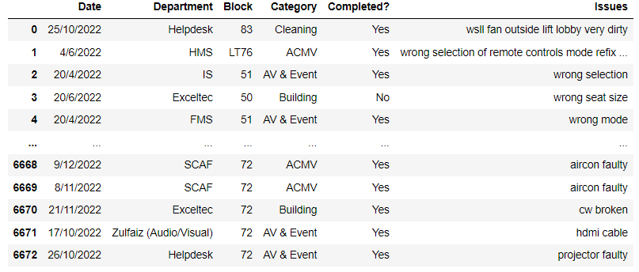
NLP on jupyter
Did not remove stopwords
Stemming produced the best results
Final Dataset:
Notes:
I tried removing stop words but the results were not good. I compared between Lemmatization and Stemming, in the end, stemming did a better job even though lemmatization usually is the better option.

Slide 35
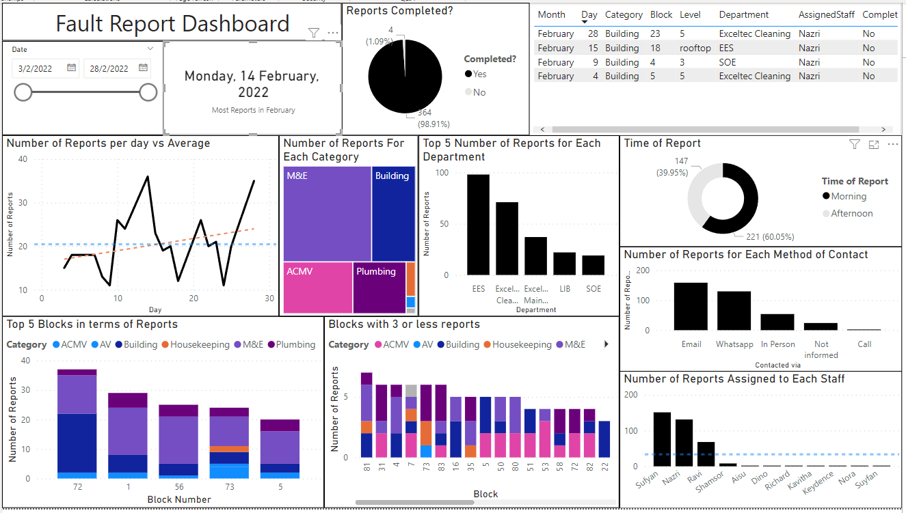
Fault Reporting: Dashboard Overview(Before)
Notes:
These are my dashboards before.

Slide 36
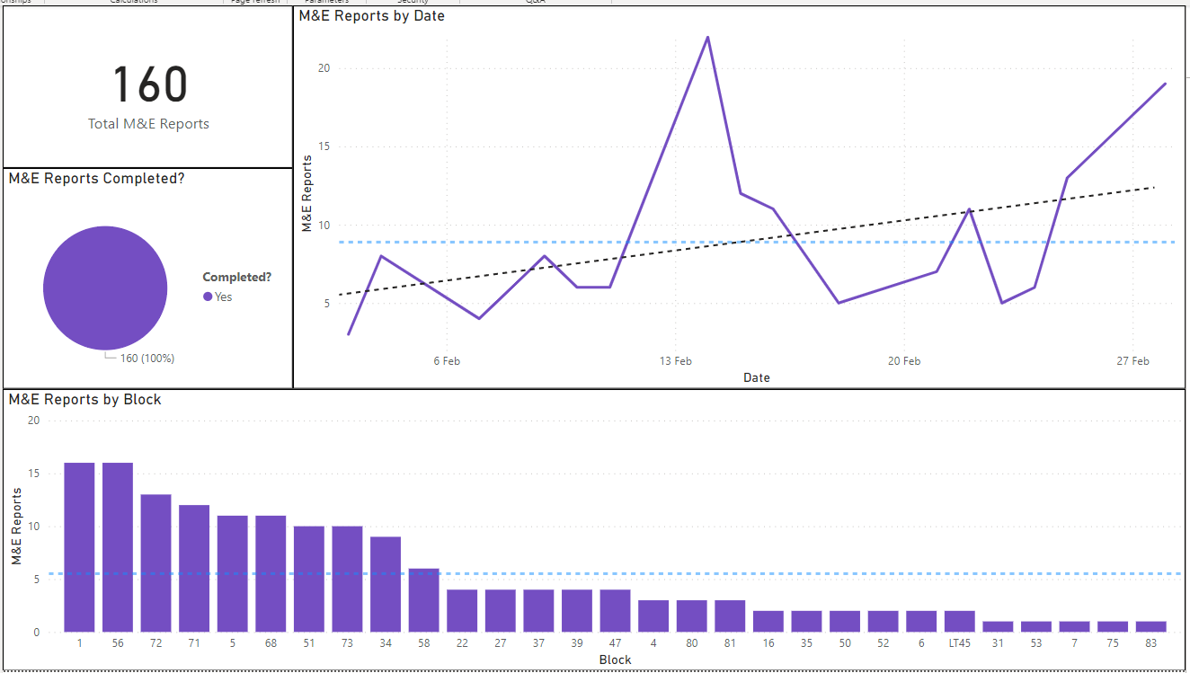
Fault Reporting: Category Dashboards(Before)

Slide 37
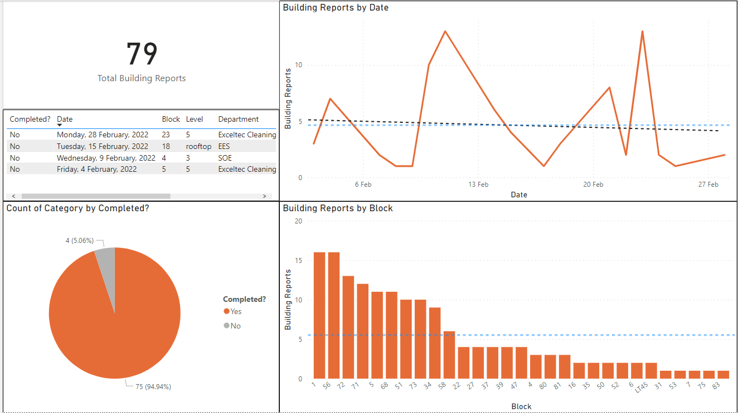

Slide 38
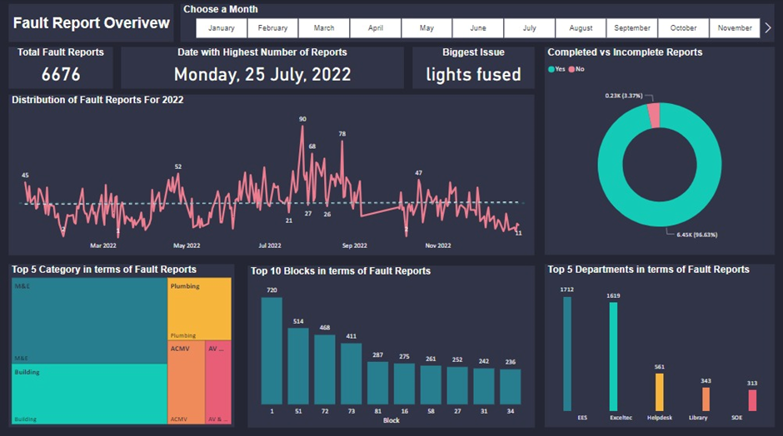
Overview Dashboard (After)
Notes:
These are my dashboards after. Main changes include the dashboard of incomplete reports, changing from making one dashboard for each category to one single dashboard where users can navigate through the different categories by using the slicer.

Slide 39
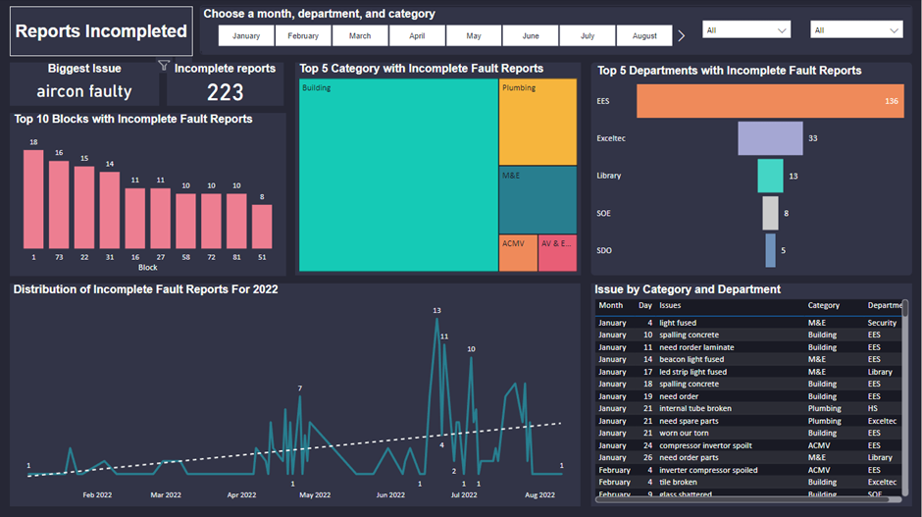
New: Incomplete Reports

Slide 40
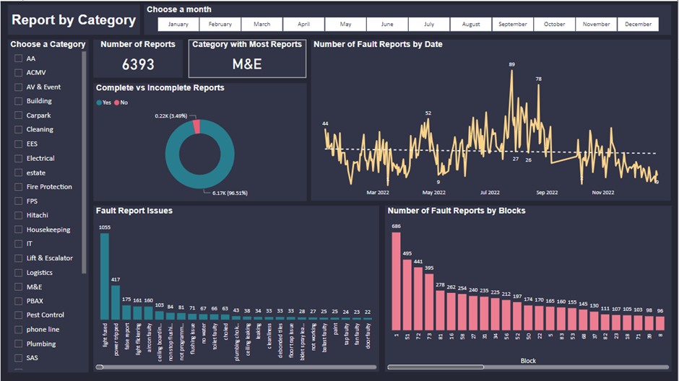
Reports by Category Dashboard(After)

Slide 41
Insights
Block 1 has the most reports complete and incomplete
M&E, Building, AV & Event, ACMV and Plumbing are the highest in terms of fault reports for category
The largest count of incomplete fault reports happened between June and July of 2022
The number of incomplete fault reports is steadily increasing
The department with the most fault reports incomplete is EES, they have 136 incomplete reports out of the total 223 incomplete fault reports
The largest count of fault reports is the issue: light fused
Notes:
These are my key insights from the dashboards. (Read off slide)

Slide 42
Canteen Crowd
Lim Wee Liang Kelven

Slide 43
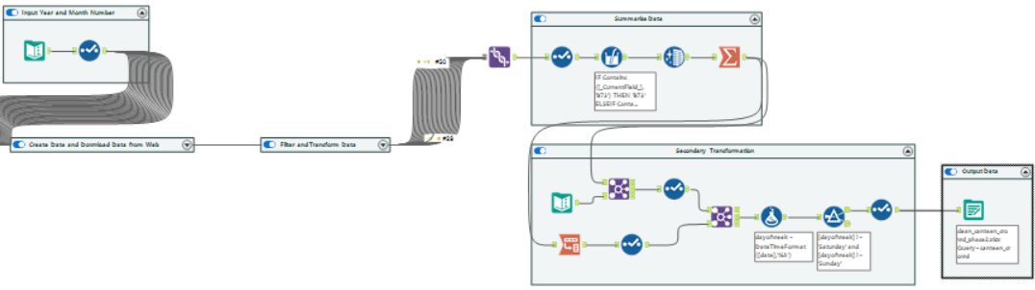
Alteryx (Before)
By: Lim Wee Liang Kelven
Notes:
For canteen crowd, I made some changes to my Alteryx workflow. This is what it looks like before.

Slide 44
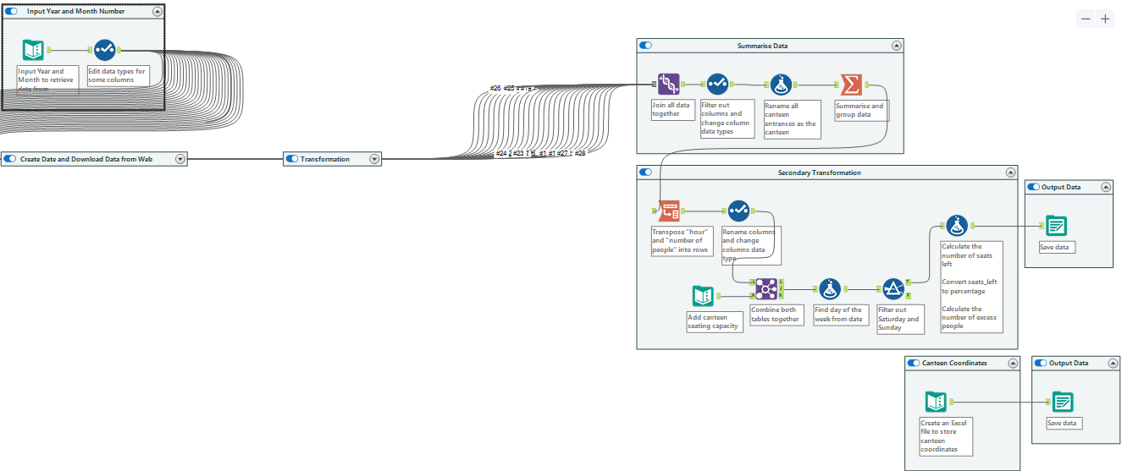
Alteryx (After)
By: Lim Wee Liang Kelven
Notes:
And this is what it looks like after. I found the canteen coordinates from an online map.

Slide 45
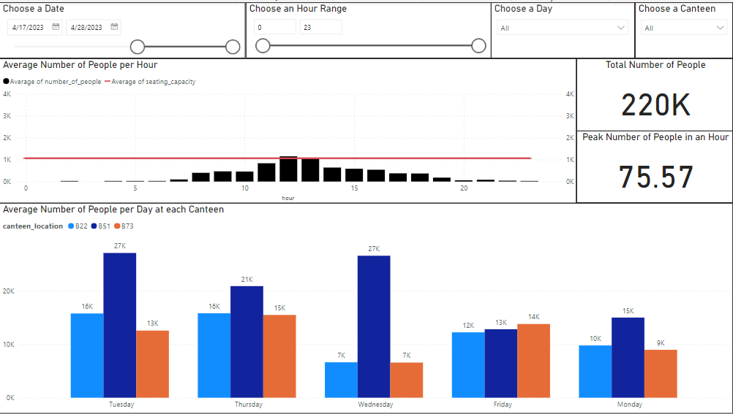
Canteen Crowd (Before)
By: Lim Wee Liang Kelven
Notes:
For energy consumption overview, this is what it looks like before.

Slide 46
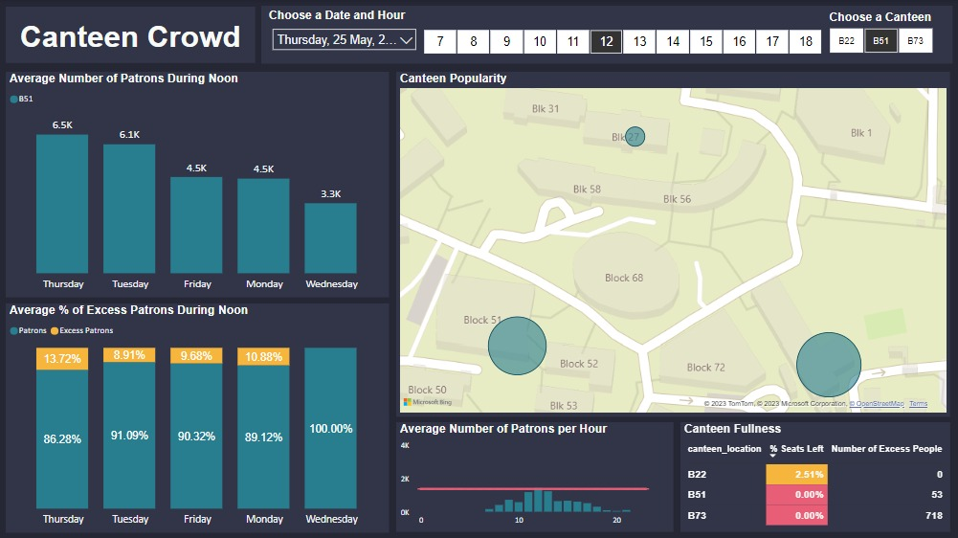
Canteen Crowd (After)
By: Lim Wee Liang Kelven
Notes:
This is what it looks like after. The main changes are the map, and the percent bar charts

Slide 47
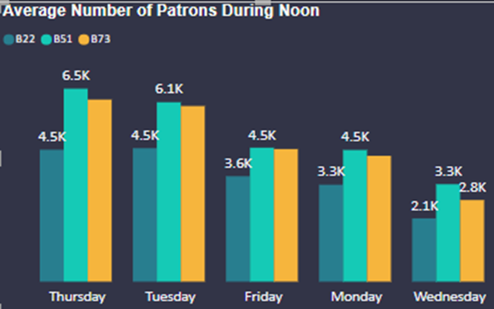
Insights
By: Lim Wee Liang Kelven
Thurs has the greatest number of people
More lessons shifted to Mondays and Wednesdays
Notes:
Canteen Crowd (CC)
Regarding the column chart in CC, it is observed that Thursdays have the greatest number of people

Slide 48
Insights
By: Lim Wee Liang Kelven
Wed has the least number of people.
Could be due to ICT students not coming to school On Wednesdays.
Food vendors can prepare less food and the number of cleaners can be reduced.
Notes:
Using the same column chart above, Wednesdays have the least number of people. This reduction is partly due to students from the School of ICT having online asynchronous classes on Wednesdays. Food vendors could reduce the amount of food to prepare, and the number of cleaners could also be reduced.

Slide 49
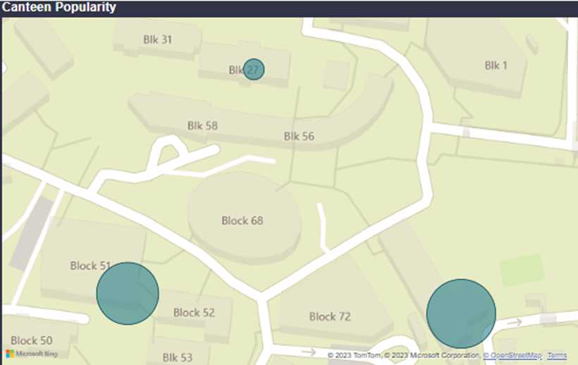
Insights
By: Lim Wee Liang Kelven
Notes:
Regarding the map chart in CC, B73 has the greatest number of people at 1498, followed by B51 with 1426, and B27 with 1009.

Slide 50
Insights
By: Lim Wee Liang Kelven
B22 has the least number of patrons
A possible solution to attract more students to B22 is moving some stalls
B22 has several vacant lots. Moving 1 or 2 food stalls to B22 could spread out traffic across each canteen
Notes:
Regarding the earlier charts from CC, B22 is the lowest of all of them. B22 has 4.5 k patrons on average on Thursday noon. A possible solution to attract more students to B22 is moving some stalls. Currently, B22 has several vacant lots as compared to the other canteens which are fully occupied with food stalls. Thus, moving 1 or 2 food stalls from either B51, B73, or both to B22 could spread out traffic across each canteen

Slide 51
Toilet Utilisation
Tiew Wee Xiang

Slide 52
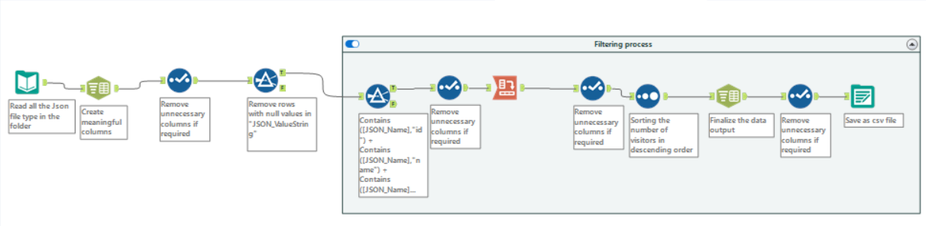
Toilet Utilisation (Frequency): Alteryx Solution
By: Tiew Wee Xiang
Notes:
For the the alteryx solution regarding toilet frequency, the main body was not changed as the output was able to help me create the visuals that I wanted. The only difference is that annotations were added to each tool, explaining the purpose of it.

Slide 53
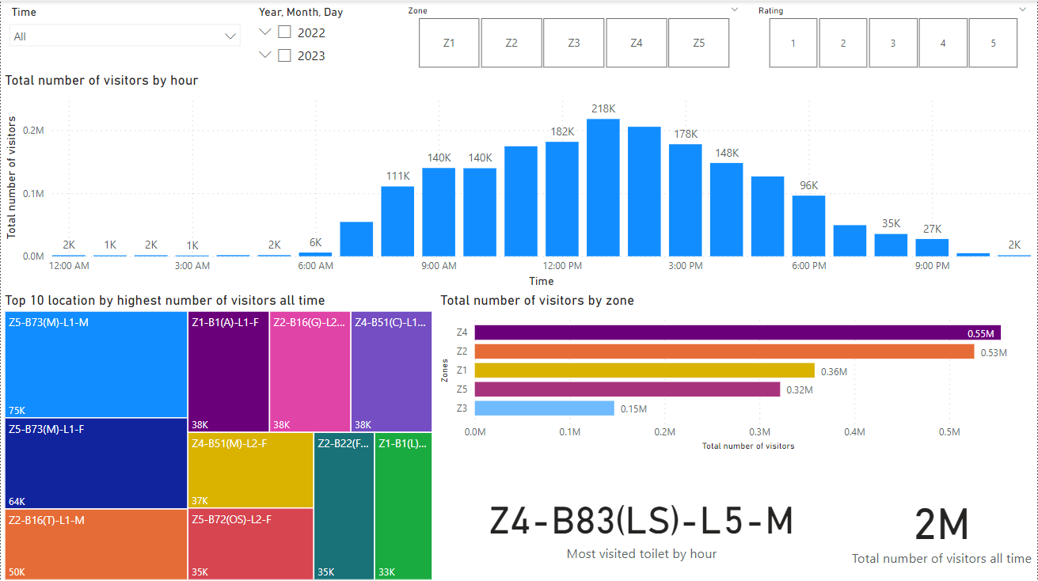
Dashboard: Toilet Frequency [Before]
By: Tiew Wee Xiang
Notes:
This is the dashboard that was created in the past.

Slide 54
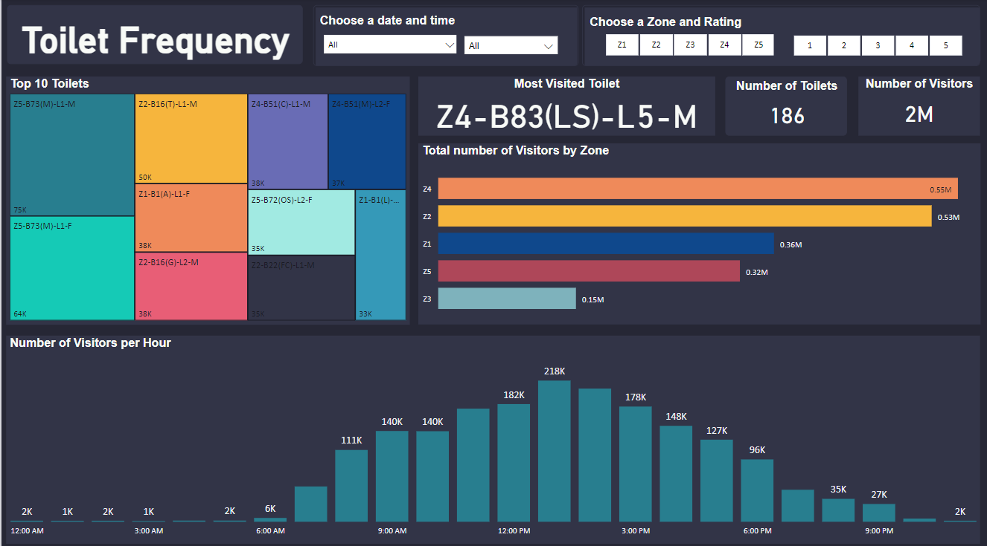
Dashboard: Toilet Frequency [After]
By: Tiew Wee Xiang
Notes:
This is the final dashboard created where it provides facility manager insights on how they can better allocate the cleaning team to improve cleaning efficiency and effectiveness. For example, the bar chart shown above shows that Z4 has the most number of visitors and Z3 has the least. To improve the cleaning efficiency and effectiveness, facility manager can allocate lesser man power to Z3 and more manpower to Z4 instead.

Slide 55
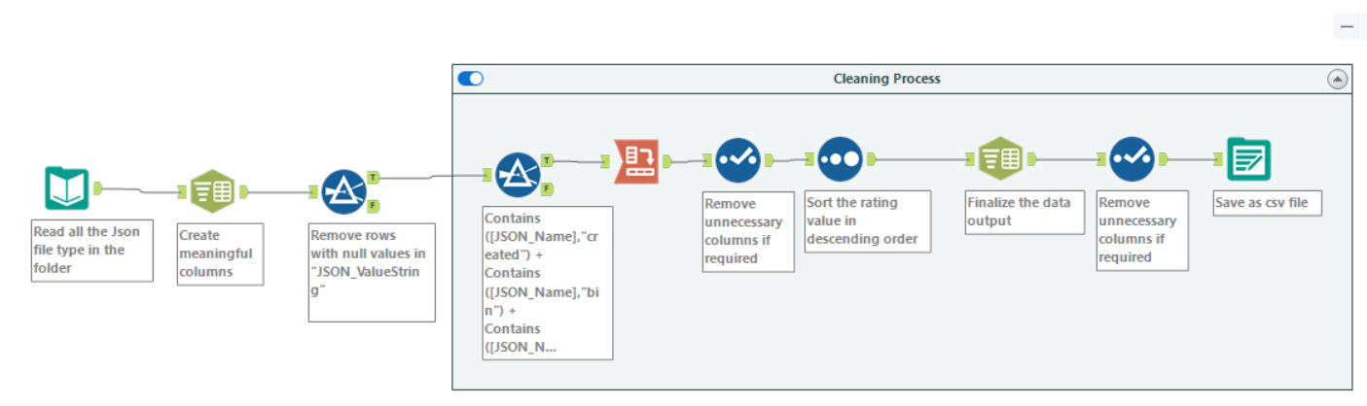
Toilet Utilisation (Feedback): Alteryx Solution
By: Tiew Wee Xiang
Notes:
For the second component for toilet utilization, it is the feedbacks given by user. The above shown the updated alteryx solution with annotations on it.

Slide 56
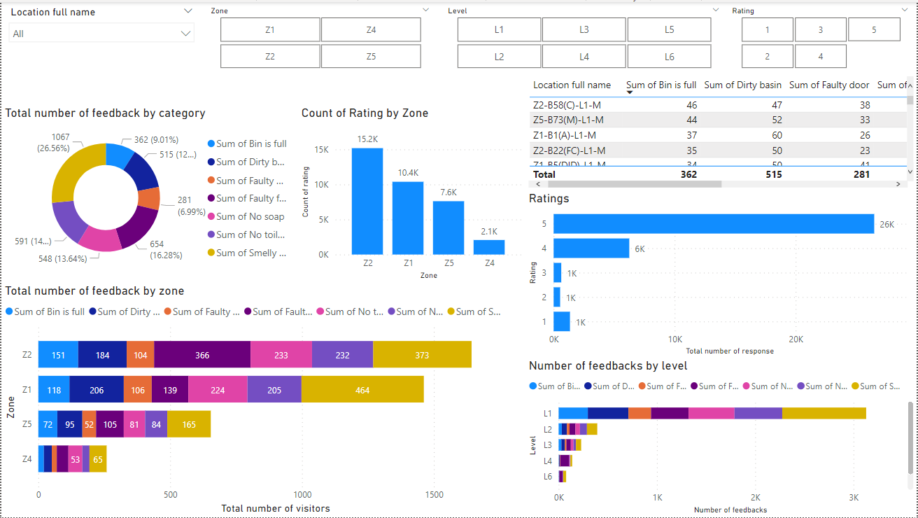
Dashboard: Toilet Feedback [Before]
By: Tiew Wee Xiang
Notes:
This is the dashboard created for Toilet Feedback back then.

Slide 57
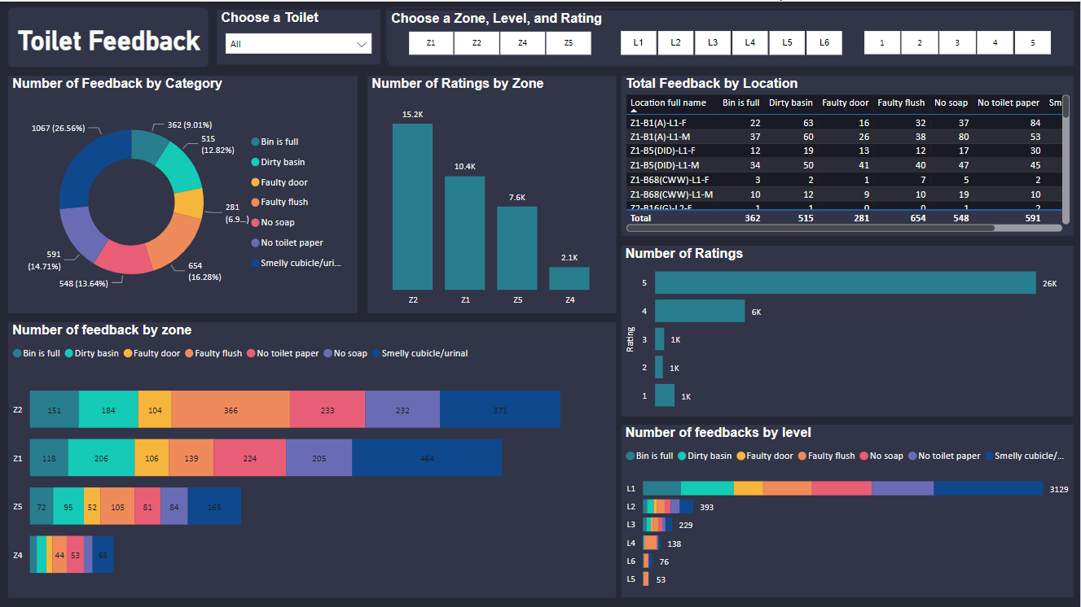
Dashboard: Toilet Feedback [After]
By: Tiew Wee Xiang
Notes:
This is the final toilet feedback dashboard created where it shows facility managers about the feedback given by user. For example, in the donut chart it was shown that majority of the feedbacks given are regarding smelly cubicle. Facility managers can then notify the cleaning team about users giving feedback regarding smelly cubicles. The cleaning team can then pay more attention to this issue to improve the overall toilet user experience.

Slide 58
Solar Energy
Tiew Wee Xiang

Slide 59
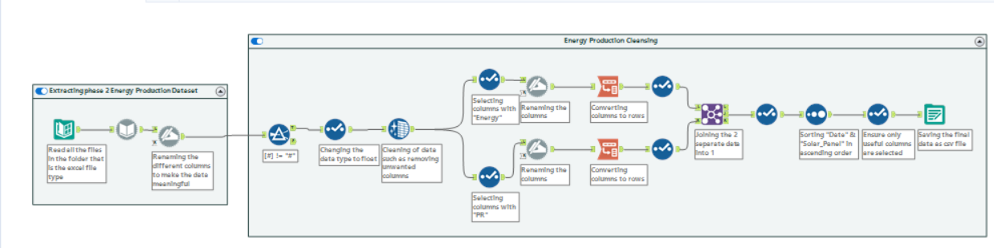
Solar Energy (Energy Production): Alteryx Solution
By: Tiew Wee Xiang
Notes:
Moving on to solar energy, there are also 2 components to it. The first component is energy production, and the above shows the alteryx solution with annotations

Slide 60
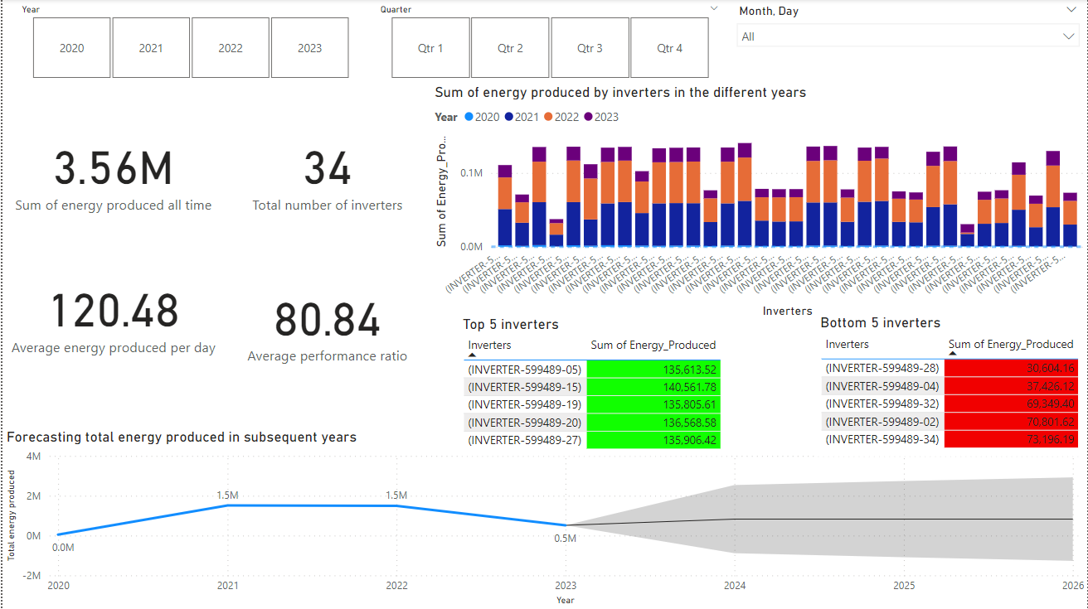
Dashboard: Energy production [Before]
By: Tiew Wee Xiang
Notes:
This is the dashboard created back then

Slide 61
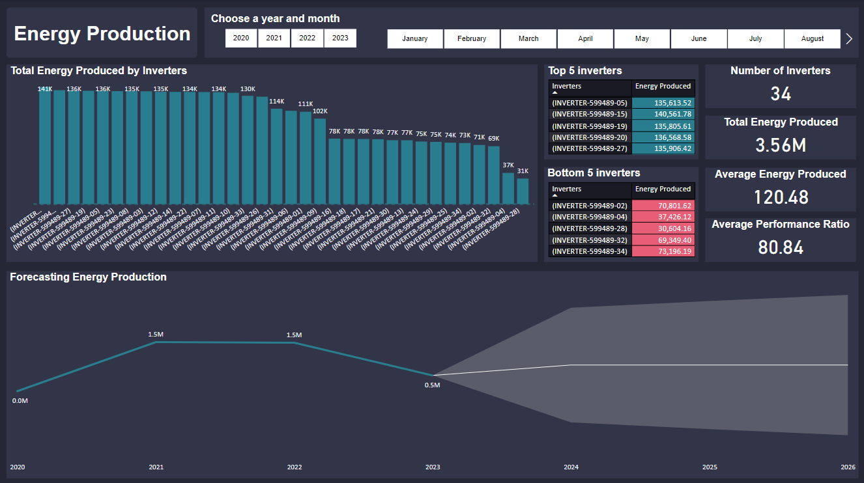
Dashboard: Energy production [After]
By: Tiew Wee Xiang
Notes:
This is the final dashboard created, providing facility managers with insights regarding the inverters. For example, the column charts have shown the energy produced across all the different inverters. On average, the total energy produced should be approximately 100k. However, there are 2 inverters that are underperforming. Facility managers can then conduct maintenance to check if there are any faults between the different inverters. As for the chart below, it shows the forecasted energy produce for the subsequent years and this is beneficial for facility managers in terms of reducing the school’s electrical bill.

Slide 62
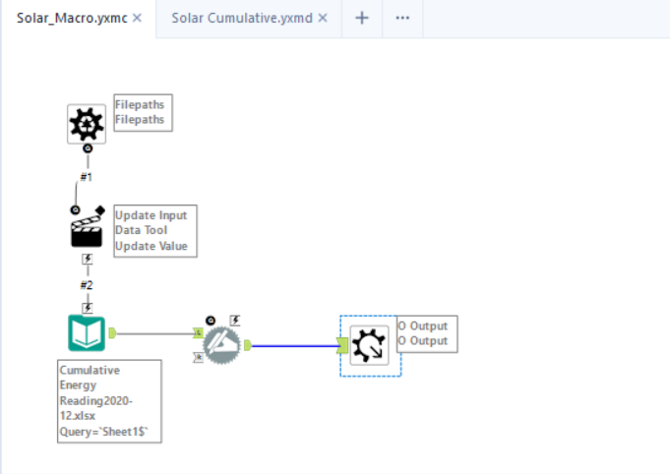

Solar Energy (Solar cumulative): Alteryx Solution
By: Tiew Wee Xiang
Notes:
Moving on to the second component, this is the alteryx solution for solar cumulative

Slide 63

Dashboard: Solar cumulative [Before]
By: Tiew Wee Xiang
Notes:
This is the dashboard created back then.

Slide 64

Dashboard: Solar cumulative [After]
By: Tiew Wee Xiang
Notes:
This is the final dashboard created where it will provide facility managers with insights regarding the performance of the different solar panel. For example, the column chart shows the total power accumulated across the different solar panels. In this case, we can see that the worse performing panels have only accumulated 33m power. Facility managers can then conduct maintenance to see if there are any faults regarding the solar panel. However, facility managers have to keep in mind that the surface area of solar panel affects the total power accumulated.

Slide 65


Telegram Bot
Notes:
So we have included a Telegram bot, which shows all the facilities' dashboard.
Simply initiate the bot, select the facility that we want to see, in this example, we picked “6” which is Canteen Crowd, and it will show the dashboard.

Slide 66


Project Artefact
Notes:
In the velocity chart, from sprint 4 to 5, there was a bit of a slowdown due to submissions for assignments.
As for the burndown chart, we completed most user stories by asg 2. In the 3rd and 4th sprint, we focused on cleaning the phase 2 datasets and how to better answer the user stories.

Slide 67
Contribution Table
Name | Number of Tasks | User Story Points
Ally Koh​ | 7 | 48.7
Tiew Wee Xiang​ | 11 | 57.8
Muhammad Nuriman​ | 7 | 54.1
Lim Wee Liang Kelven​ | 11 | 68.5
Marcus Chua Chow Lee​ | 7 | 43.4
Notes:
This is our contribution table. The tasks and user story points are taken from our group’s Trello Board.

Slide 68
Thank you!
Please keep this slide for attribution
Notes:
That is the end of our presentation. Thank you. :)

